Slide 1
Cryptography and Network Security
Principles of Public-Key Cryptosystems
Presented by MD ABDUS SAHID

Slide 2
Evolved from an attempt to solve two of the most difficult problems associated with symmetric encryption.
Key distribution
Digital signature
Diffie and Hellman in 1976 came up with a method

Slide 3
 Each user generates a pair of keys to be used for the encryption and decryption
 Each user places one of the two keys in a public register or
other accessible file. This is the public key
 The other key is kept private, which is the private key
 Either of the two related keys can be used for encryption, with the other used for decryption.

Slide 4
A public-key encryption scheme has six
ingredients
Plaintext
Encryption algorithm
Public key
Private key
Cipher text
Decryption algorithm

Slide 5
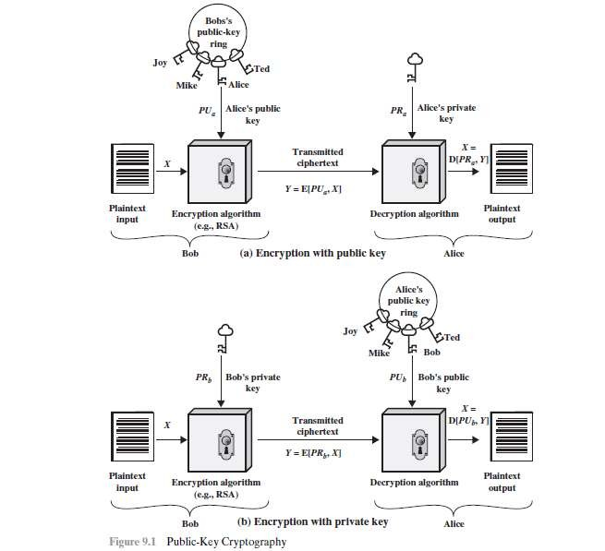

Slide 6
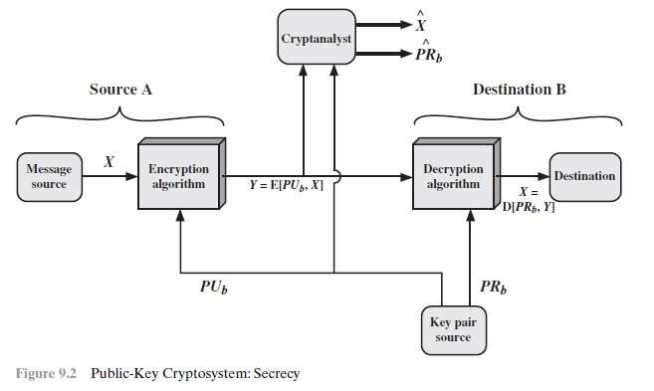
Encryption using Public key

Slide 7
 With the message X and the encryption key PUb as input
A forms the ciphertext Y , given by
Y = E(PUb, X)
Receiver in possession of the matching private key PRb, is able to invert the transformation
X = D(PRb,Y)

Slide 8
 An adversary, observing Y and having access to PUb, but not
having access to PRb or X, must attempt to recover X and/or
PRb.
It is assumed that the adversary does have knowledge of the
encryption (E) and decryption (D) algorithms.
If the adversary is interested only in this particular message, then the focus of effort is to recover X by generating a plaintext estimate Xn .
Often, however, the adversary is interested in being able to read future messages as well, in which case an attempt is made to recover PRb by generating an estimate PRnb.

Slide 9
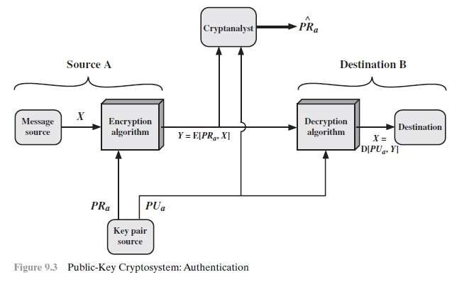
Encryption using Private key

Slide 10
 A encrypts it using A’s private key before transmitting it.
B can decrypt the message using A’s public key.
Y = E(PRa,X)
X = D(PUa,Y)
Only A could have prepared the message, Therefore, the entire encrypted message serves as a digital signature.

Slide 11
 In addition, it is impossible to alter the message without
access to A’s private key
 The message being sent is safe from alteration.
 But not confidentiality because any observer can decrypt the
message by using the sender’s public key.

Slide 12
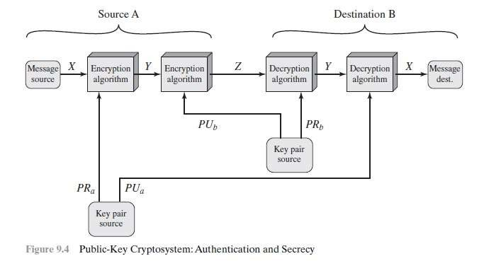
Authentication and confidentiality

Slide 13
 Both the authentication function and confidentiality by a double use of the public-key scheme
 Z = E(PUb, E(PRa,X))
 X = D(PUa, D(PRb, Z))

Slide 14
 We begin by encrypting a message, using the sender’s private
key.
This provides the digital signature.
Next, we encrypt again, using the receiver’s public key.
 The final ciphertext can be decrypted only by the intended
receiver, who alone has the matching private key.
 Thus, confidentiality is provided.

Slide 15
Applications for Public-Key Cryptosystems
Encryption/decryption
Digital signature
Key exchange
Some algorithms are suitable for all three applications,
Some used only for one or two of these applications.

Slide 16
Requirements for Public-Key Cryptography
1. It is computationally easy for a party B to generate a pair of key (public key PUb, private key PRb).
2. It is computationally easy for a sender A, knowing the public key and the message to be encrypted, M, to generate the corresponding ciphertext:
 C = E(PUb, M)
3. It is computationally easy for the receiver B to decrypt the resulting ciphertext using the private key to recover the original message:
 M = D(PRb,C) = D[PRb, E(PUb,M)]

Slide 17
the public key, PUb, to determine the private key, PRb.
 4. It is computationally infeasible for an adversary, knowing
 5. It is computationally infeasible for an adversary, knowing
the public key, PUb, and a ciphertext, C, to recover the
original message, M
 6. The two keys can be applied in either order:
 M = D[PUb, E(PRb, M)] = D[PRb, E(PUb, M)]

Slide 18
Public-Key Cryptanalysis
Vulnerable to a brute-force attack.
The countermeasure is the same: Use large keys.
Key size must be large enough to make brute-force attack impractical but small enough for practical encryption and decryption.

Slide 19
thank you

